Slide 1

Have hybrid procedures replaced open aortic arch reconstruction in high-risk patients? A comparative study of elective open arch debranching with endovascular stent graft placement and conventional elective open total and distal aortic arch reconstruction
Rita Karianna Milewski, MD, PhD, Wilson Y. Szeto, MD, Alberto Pochettino, MD, G. William Moser, CRNP, Patrick Moeller, BS, Joseph E. Bavaria, MD
The Journal of Thoracic and Cardiovascular Surgery
Volume 140, Issue 3, Pages 590-597 (September 2010)
DOI: 10.1016/j.jtcvs.2010.02.055
Copyright © 2010 The American Association for Thoracic Surgery Terms and Conditions

Slide 2
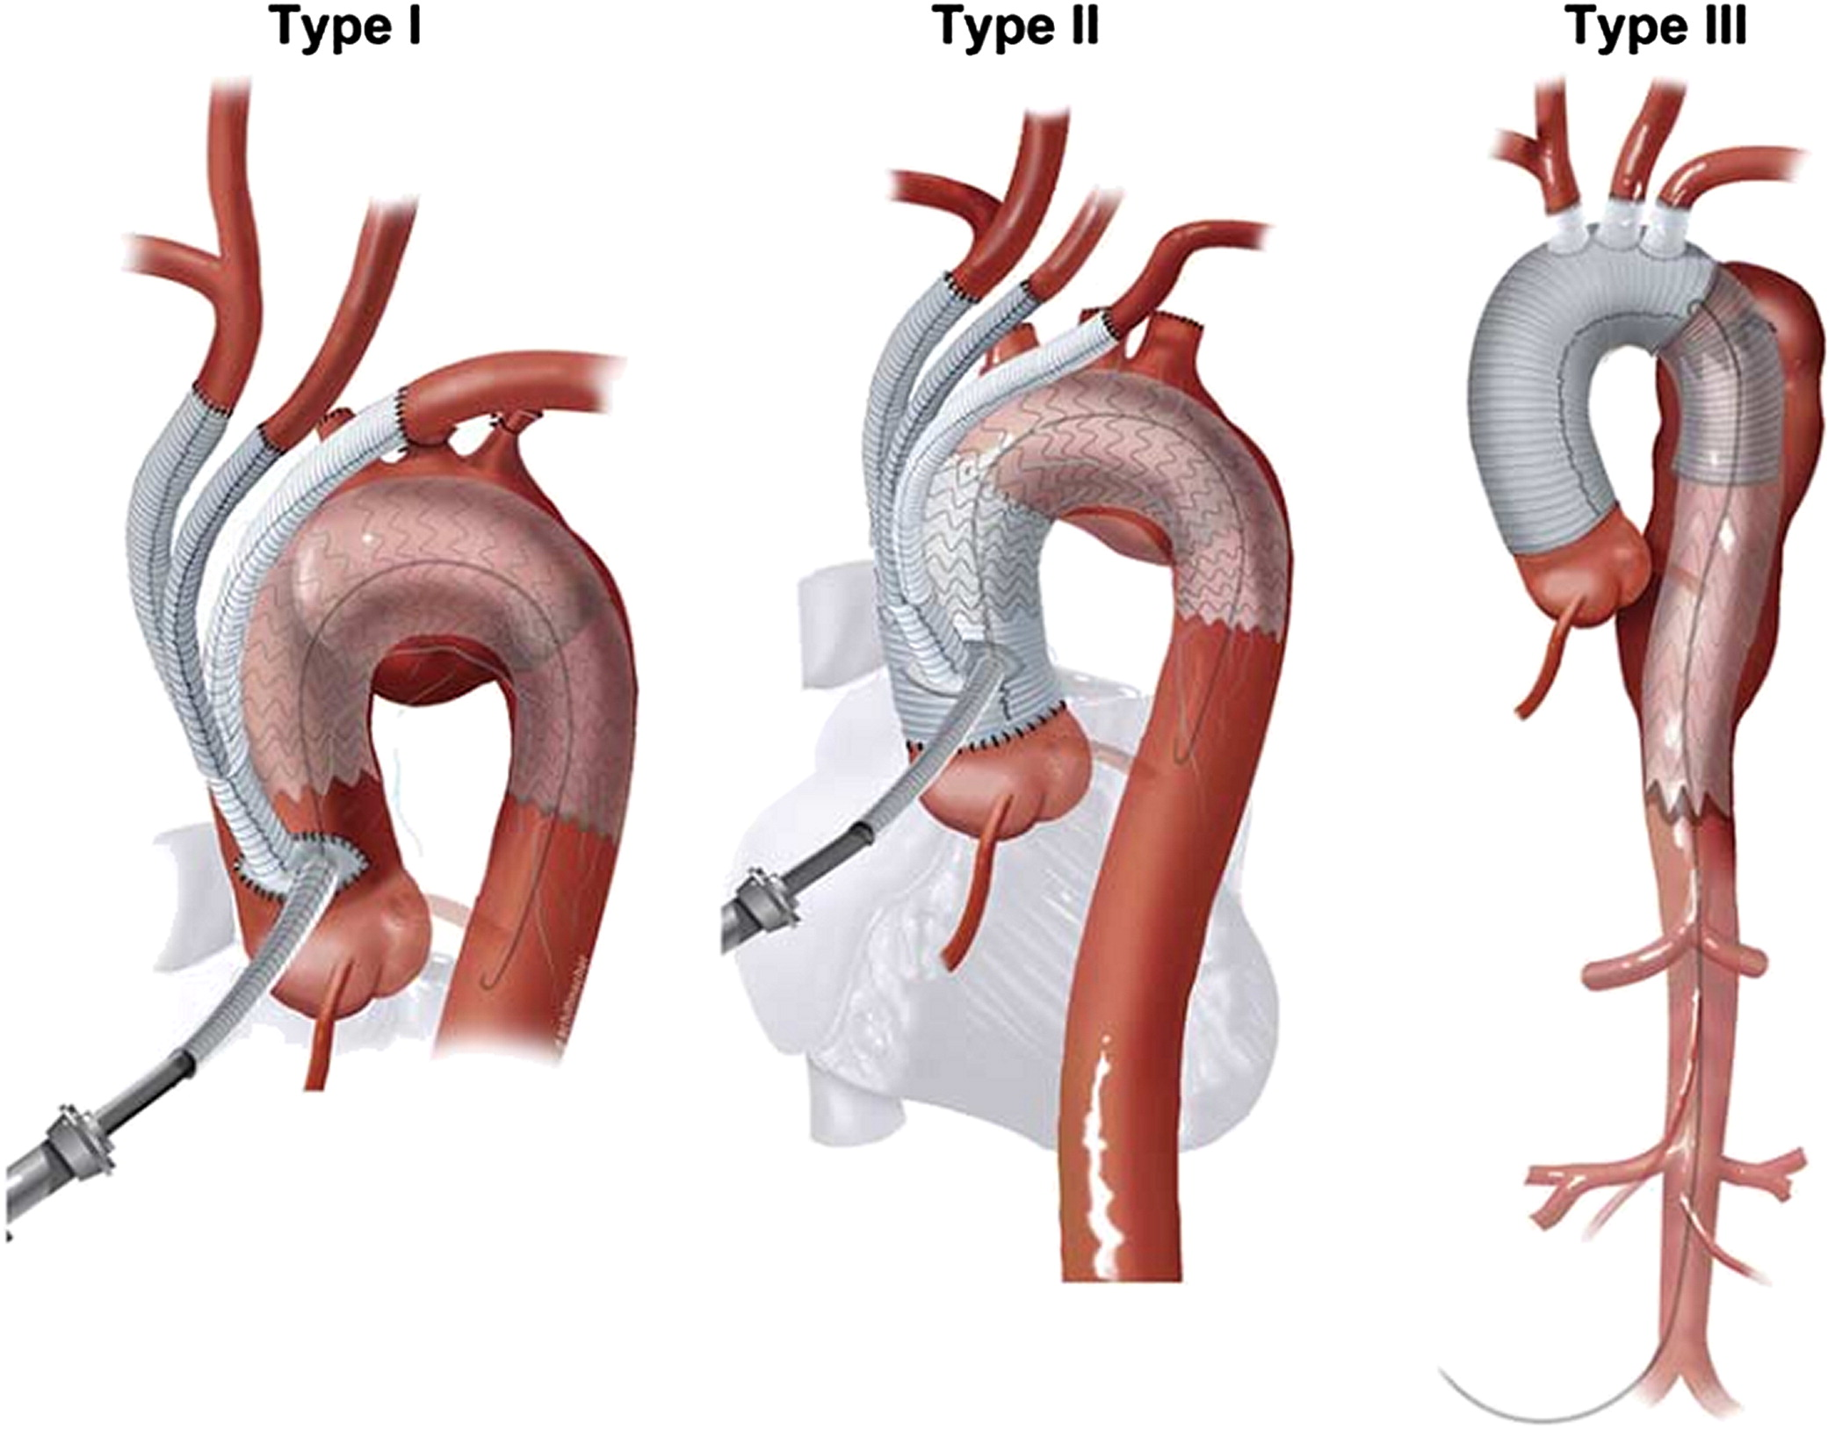
Figure 1
The Journal of Thoracic and Cardiovascular Surgery 2010 140, 590-597DOI: (10.1016/j.jtcvs.2010.02.055)
Copyright © 2010 The American Association for Thoracic Surgery Terms and Conditions
Notes:
Type I aortic pathology: For type I saccular arch aneurysm, the “classic” debranching procedure can be performed to bypass the cerebral vessels. This procedure involves the end-to-side anastomoses of a 4-branched graft to the ascending aorta. This can be done off bypass using a sidebiting clamp on the ascending aorta (IA). If a limited amount of aorta exists between the STJ and the ascending aorta, a full CPB with crossclamp is required (IB). Type II aortic arch pathology: This aortic pathology has no adequate suitable native proximal aorta but has a distal aorta for antegrade deployment of the endovascular graft. However, this pathology requires reconstruction of LZ 0 with a 4-branch graft. Type III aortic arch pathology: For type III aortic arch pathology, or mega-aorta, there is no adequate suitable native proximal ascending or descending aorta. The adequate suitable distal native aorta extends just proximal to the celiac artery. Mega-aorta also requires reconstruction of LZ 0 with a branched graft. The remaining mega-aorta is addressed by intraoperative antegrade deployment of the endovascular graft or by retrograde TEVAR during the same hospitalization. In some cases, an interval between the open debranching procedure and completion of aneurysmal exclusion with further endovascular stent grafting is required (IIIB).

Slide 3
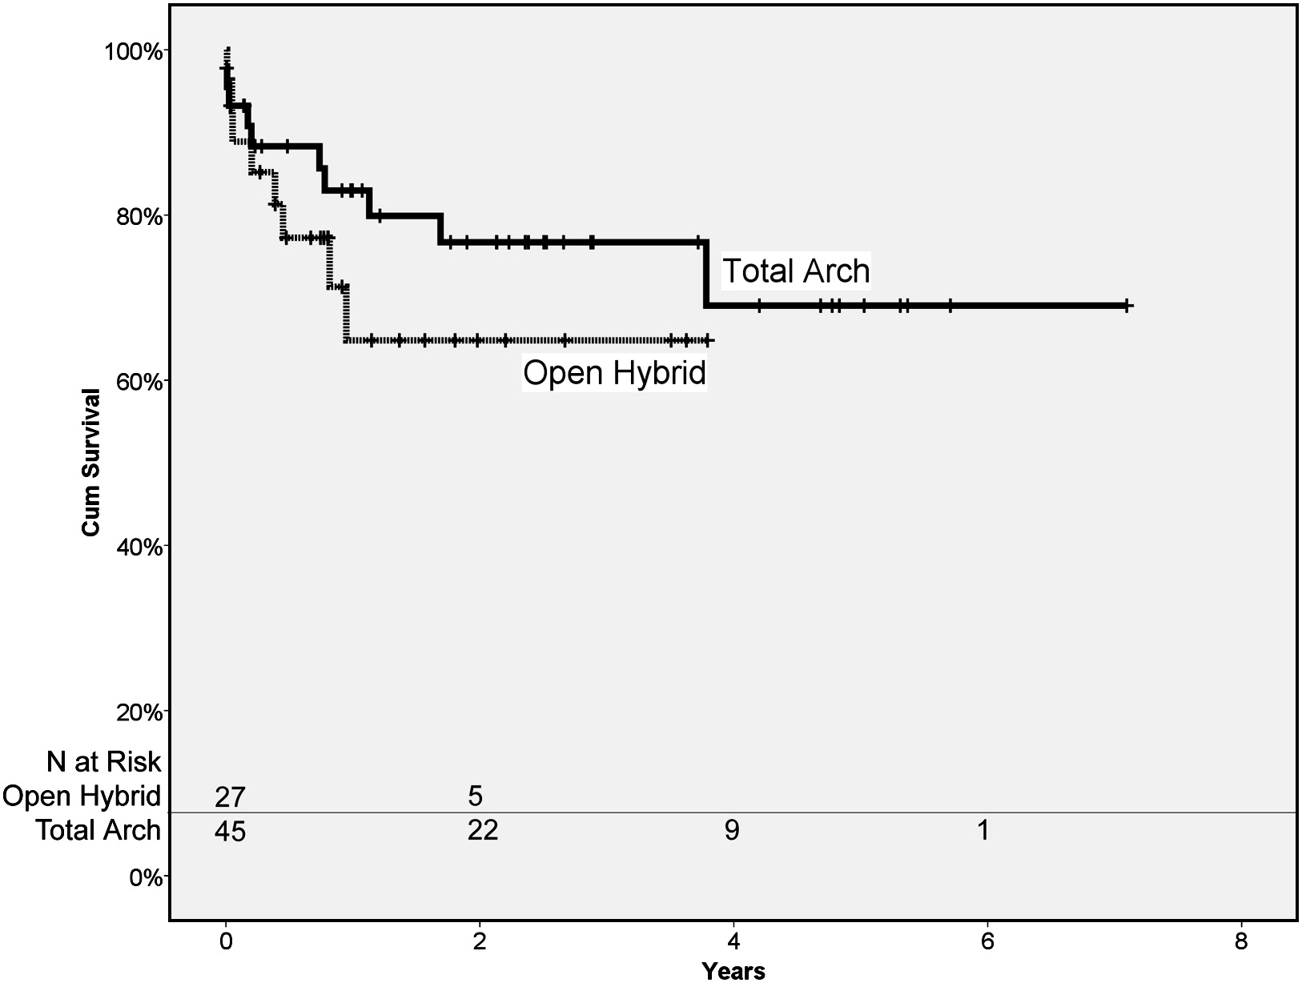
Figure 2
The Journal of Thoracic and Cardiovascular Surgery 2010 140, 590-597DOI: (10.1016/j.jtcvs.2010.02.055)
Copyright © 2010 The American Association for Thoracic Surgery Terms and Conditions
Notes:
Kaplan–Meier survival plot, all causes of death. P value between groups is .32 (log rank).

